Slide 1
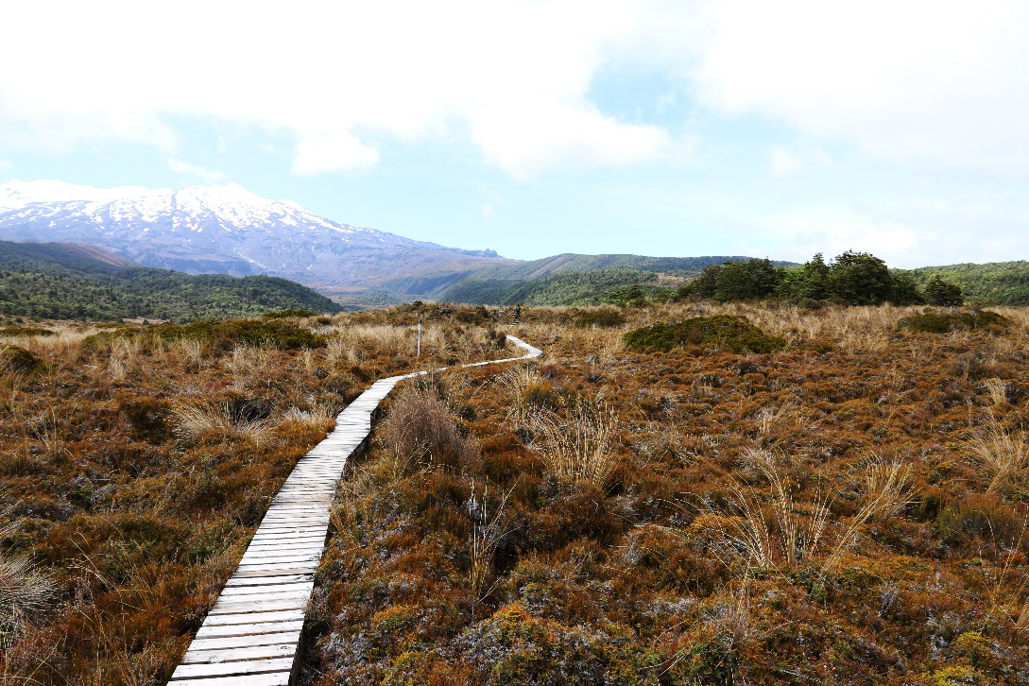


Global conservation of species’ niches
Jeffrey Hanson
jeffrey.hanson@uqconnect.edu.au
jeffrey-hanson.com

Slide 2



Acknowledgements
Richard Fuller
Jonathan Rhodes
Stuart Butchart
Graeme Buchanan
Carlo Rondinini
Francesco Ficetola
NecTAR project

Slide 3
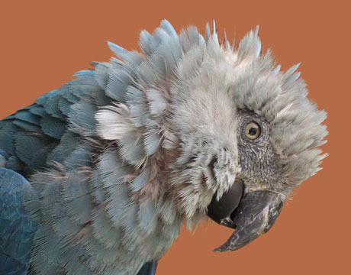
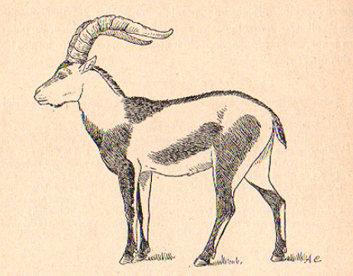
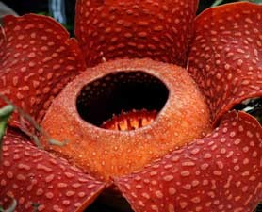
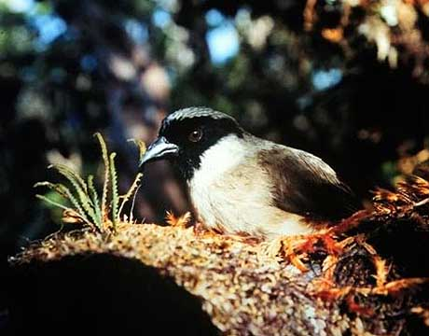
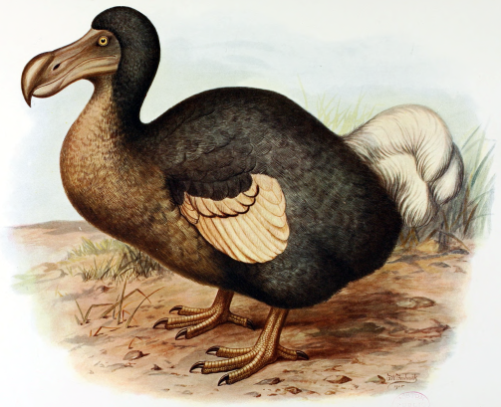
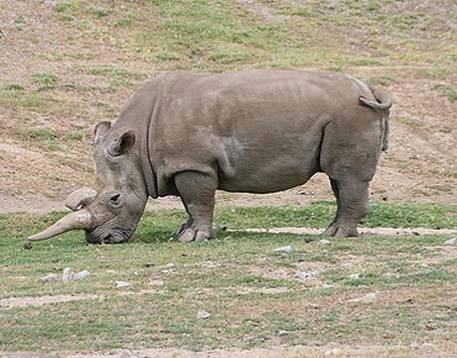
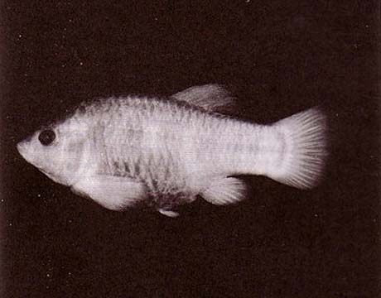
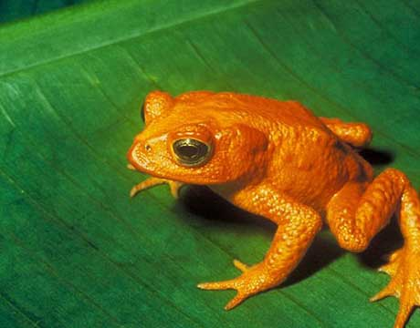
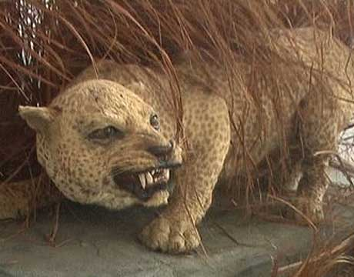
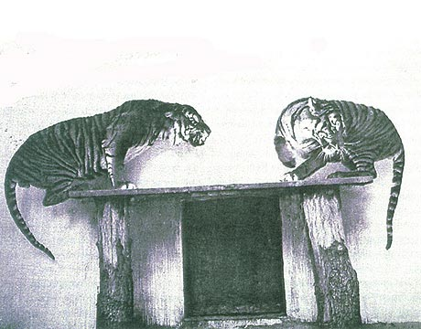
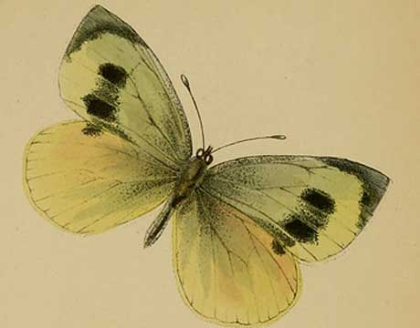
Global biodiversity crisis
Notes:
- high extinction rate
- conservation aims to maintain existing patterns of biodiversity and the processes that sustain them
- areas set aside to preserve biodiversity, and spearhead direct management actions

Slide 4
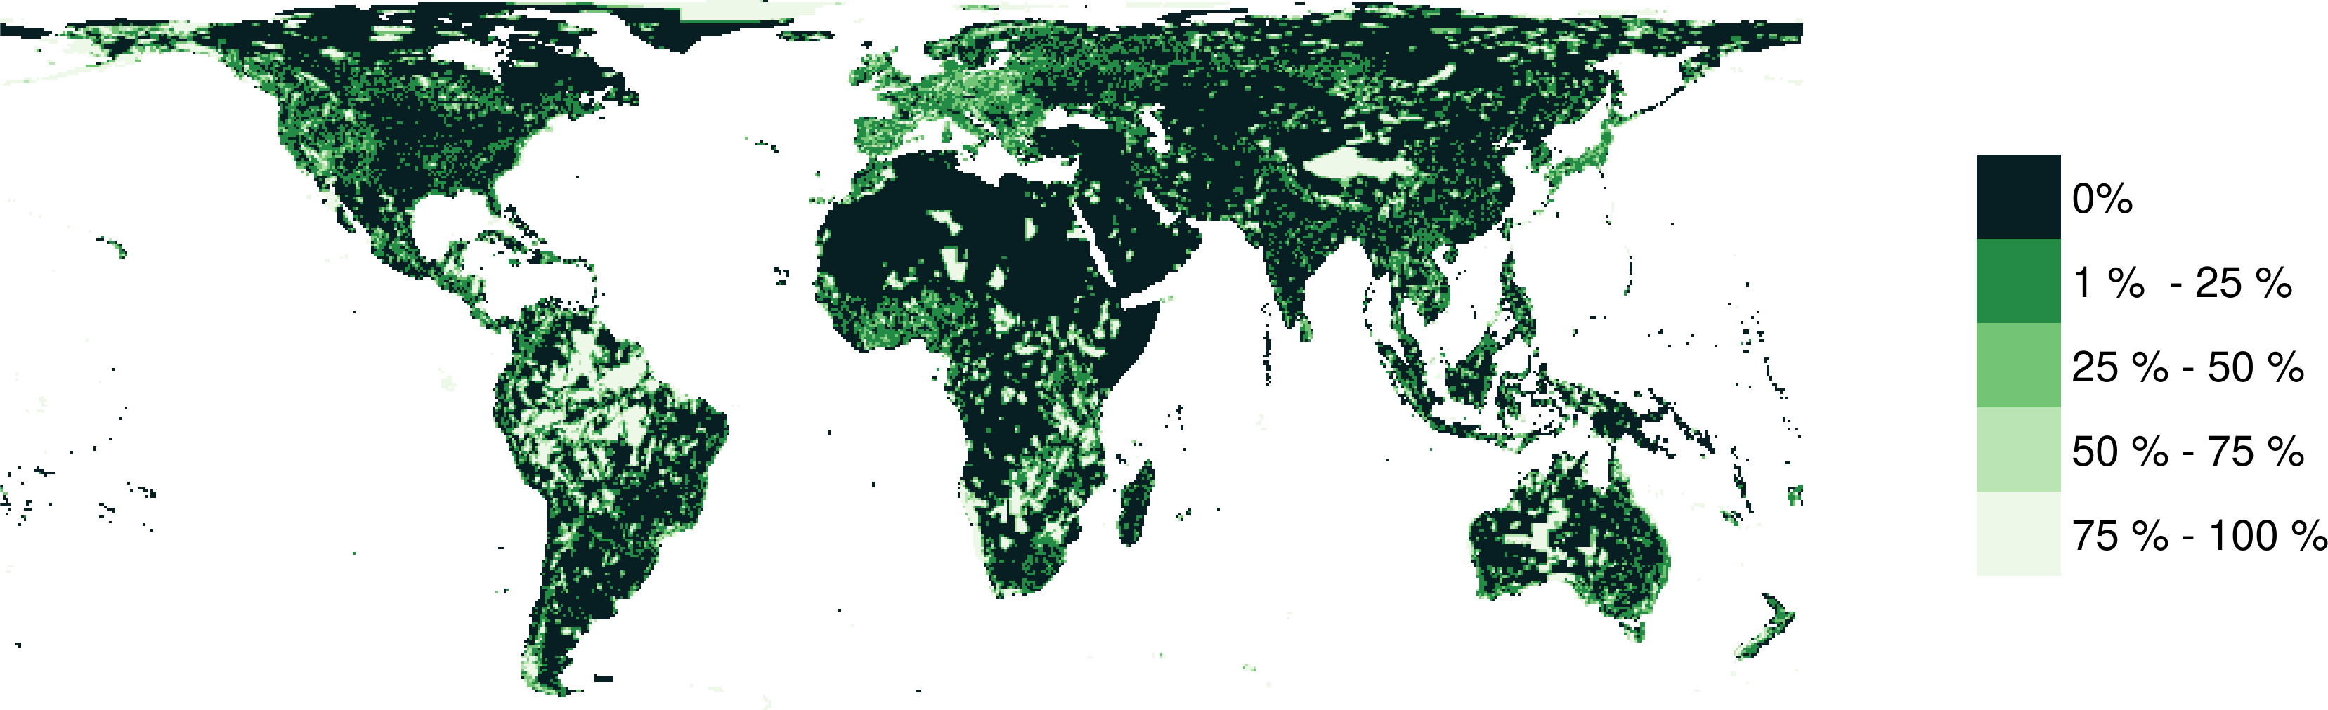
Protected areas

Slide 5





CARE Principles
Comprehensive
Adequate
Representative
Efficient
versus

Slide 6
CARE Principles
Comprehensive
Adequate
Representative
Efficient
versus

Slide 7
CARE Principles
Comprehensive
Adequate
Representative
Efficient
versus

Slide 8
CARE Principles
Comprehensive
Adequate
Representative
Efficient
versus

Slide 9
Reserve selection

Slide 10
Reserve selection
Target = 1 grid cell per species

Slide 11
Reserve selection
Target = 1 grid cell per species

Slide 12


CARE Principles
Comprehensive
Adequate
Representative
Efficient

Slide 13
Adaptive evolutionary processes
Species range
Population

Slide 14
Adaptive evolutionary processes
Species range
Population

Slide 15
Adaptive evolutionary processes
Species range
Population

Slide 16
How well are existing protected areas covering species’ realized niches?

Slide 17
Data
9,670 bird, 5,070 mammal, 5,197 amphibian species
5 × 5 km maps delineating suitable habitat
Subdivided each species’ spatial distribution into multiple “environmental partitions”
Set targets for each environmental partition for each species’ spatial distribution

Slide 18

Giant Panda
Local adaptations
in immune system

Slide 19
Italian Agile Frog

Slide 20
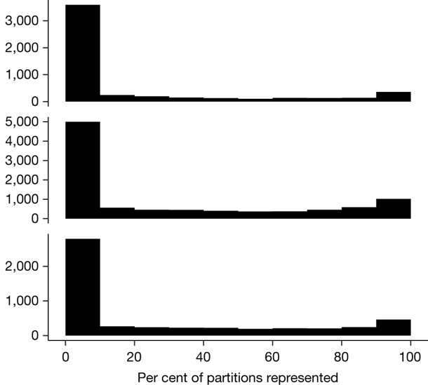
How good is the existing protected system?
Amphibians
18,097 (90%) species are not adequately represented in reserves
9,651 (48%) species do not have a single partition adequately represented
Of these, 2,385 species are globally imperilled
Birds
Number of species
Mammals

Slide 21
Where are priority areas for improving protection of species’ realized niches?

Slide 22
Decision problem
Objective:
minimize total land in solution
Constraints:
Amount of habitat for each environmental partition for each species held by solution >= target amount
Existing protected areas are locked into the solution

Slide 23
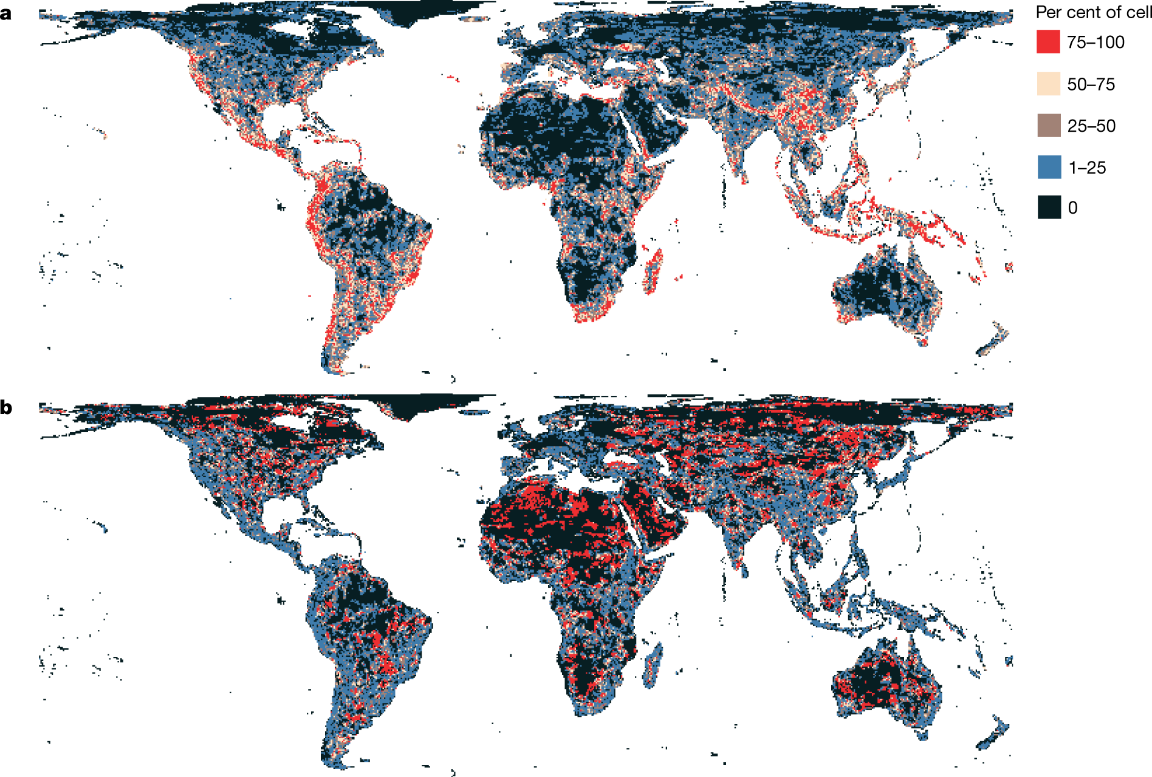
Prioritisation
34% of Earth’s land and inland waters

Slide 24
What happens if we ignore species’ niches?

Slide 25
Prioritisation without niches

Slide 26
Ignoring niches leads to poorer result
a
Only 3.2% less of the Earth’s land than prioritization which considers niches
Fails to adequately represent 7,787 (40%) species
b

Slide 27
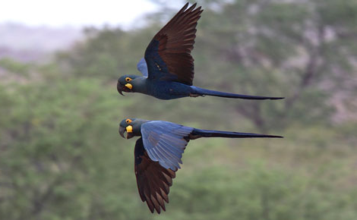
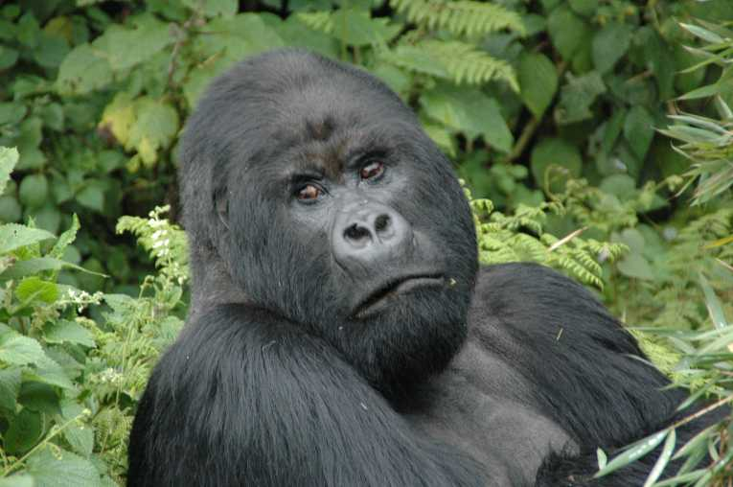
Global conservation of realized niches
Current protected area system is insufficient
More protected areas are needed to fill the gaps
Future conservation efforts need to explicitly account for environmental variation

Slide 28



jeffrey.hanson@uqconnect.edu.au
github.com/jeffreyhanson
jeffrey-hanson.com

